Slide 1
Batch – B5

Slide 2

EEC23702 -Mini Project Work
EV-Agent: Agentic AI Powered Smart EV Charging Platform
Presented by.
Mr. Prasannaa DP
Mr. Rahul TH
Mr. Sharun SR
Project Coordinator
Dr. C. Srivenkateswaran
Professor
Under the guidance of​
Ms. Angalaparameswari
Assistant Professor​​
Department of Artificial Intelligence&
Data Science​​
Head of the Department
Ms. R Kannamma Assistant Professor
Department of Artificial Intelligence & Data Science
Department of Artificial Intelligence & Data Science
Final review on 28.09.26

Slide 3

Outline of the Presentation
PRATHYUSHA ENGINEERING COLLEGE
(AN AUTONOMOUS INSTITUTION)
Objective / Objectives
Literature Survey
Existing System
Scope of the Project
Proposed System
System Architecture
Methodology / Workflow
Technologies & Implementation
Result & Output
Conclusion & Future Scope
References
AIDS

Slide 4
Objectives
PRATHYUSHA ENGINEERING COLLEGE
(AN AUTONOMOUS INSTITUTION)
Optimize EV Charging – Determine the best time and method to charge an electric vehicle efficiently.
Find Available Charging Stations – Recommend suitable nearby charging stations based on availability and user requirements.
Reduce Charging Cost – Suggest cost-effective charging schedules by considering electricity prices and demand.
AIDS

Slide 5
Literature Survey
PRATHYUSHA ENGINEERING COLLEGE
(AN AUTONOMOUS INSTITUTION)
Literature Survey
Year | Title of The Research Paper | Author | Methodology | Existing System | Drawbacks
2021 | EV charging infrastructure in India | Mishra et al. | Reviewed development, infrastructure requirements and challenges of EV charging in India | EV charging infrastructure is mainly focused on deployment of charging stations, infrastructure development, and basic charging services. | No intelligent AI-based user recommendation
2022 | Optimal EV charging-station location | Ahmad et al. | Reviewed station placement, charging demand, optimization and grid impact | Existing systems focus on optimal charging-station placement, demand estimation, and grid-aware planning using location and charging-demand data. | Focuses mainly on infrastructure planning rather than real-time user assistance
AIDS

Slide 6
Literature Survey
PRATHYUSHA ENGINEERING COLLEGE
(AN AUTONOMOUS INSTITUTION)
Literature Survey
Year | Title of The Research Paper | Author | Methodology | Existing System | Drawbacks
2023 | Charging technologies & station recommendation | Charging Technology & Recommendation Review | Reviewed charging technologies, infrastructure and station-finding/recommendation methods | Existing systems provide charging-station recommendation based on station location, availability, charging requirements, and user preferences. | Does not provide an Agentic AI system capable of reasoning and taking actions
AIDS

Slide 7
Existing System & Problems
PRATHYUSHA ENGINEERING COLLEGE
(AN AUTONOMOUS INSTITUTION)
Existing System
Manual Charging : Users manually select when and where to charge.
Basic Charging Apps : Show charging stations and their availability.
Fixed Scheduling : Charging is scheduled using predefined time slots.
Limited AI : Existing systems provide basic recommendations.
Problems
High charging cost during peak hours.
Charging stations may be unavailable when users arrive.
No personalized charging plans.
Limited real-time decision-making.
AIDS

Slide 8
Scope of the Project
PRATHYUSHA ENGINEERING COLLEGE
(AN AUTONOMOUS INSTITUTION)
Smart Charging – Optimize charging time based on battery level and user needs.
Station Selection – Identify suitable charging stations based on location and availability.
Cost Optimization – Recommend cost-effective charging options.
Agentic AI – Enable autonomous and intelligent charging decisions.
Personalized Planning – Adapt charging plans according to user preferences.
Energy Efficiency – Promote efficient energy usage and reduce peak demand.
AIDS

Slide 9
Proposed System
PRATHYUSHA ENGINEERING COLLEGE
(AN AUTONOMOUS INSTITUTION)
The proposed system begins by collecting user and EV details, including battery status and charging requirements. It then performs battery status analysis and collects relevant charging station data to understand available charging options. Based on the user’s requirements, the system performs charging demand prediction and identifies the most suitable charging station and time. An Agentic AI decision-making module evaluates these factors along with cost and energy consumption to determine an optimized charging strategy. Finally, the system provides a personalized charging recommendation and continuously monitors the charging process through smart charging and real-time monitoring.
AIDS

Slide 10
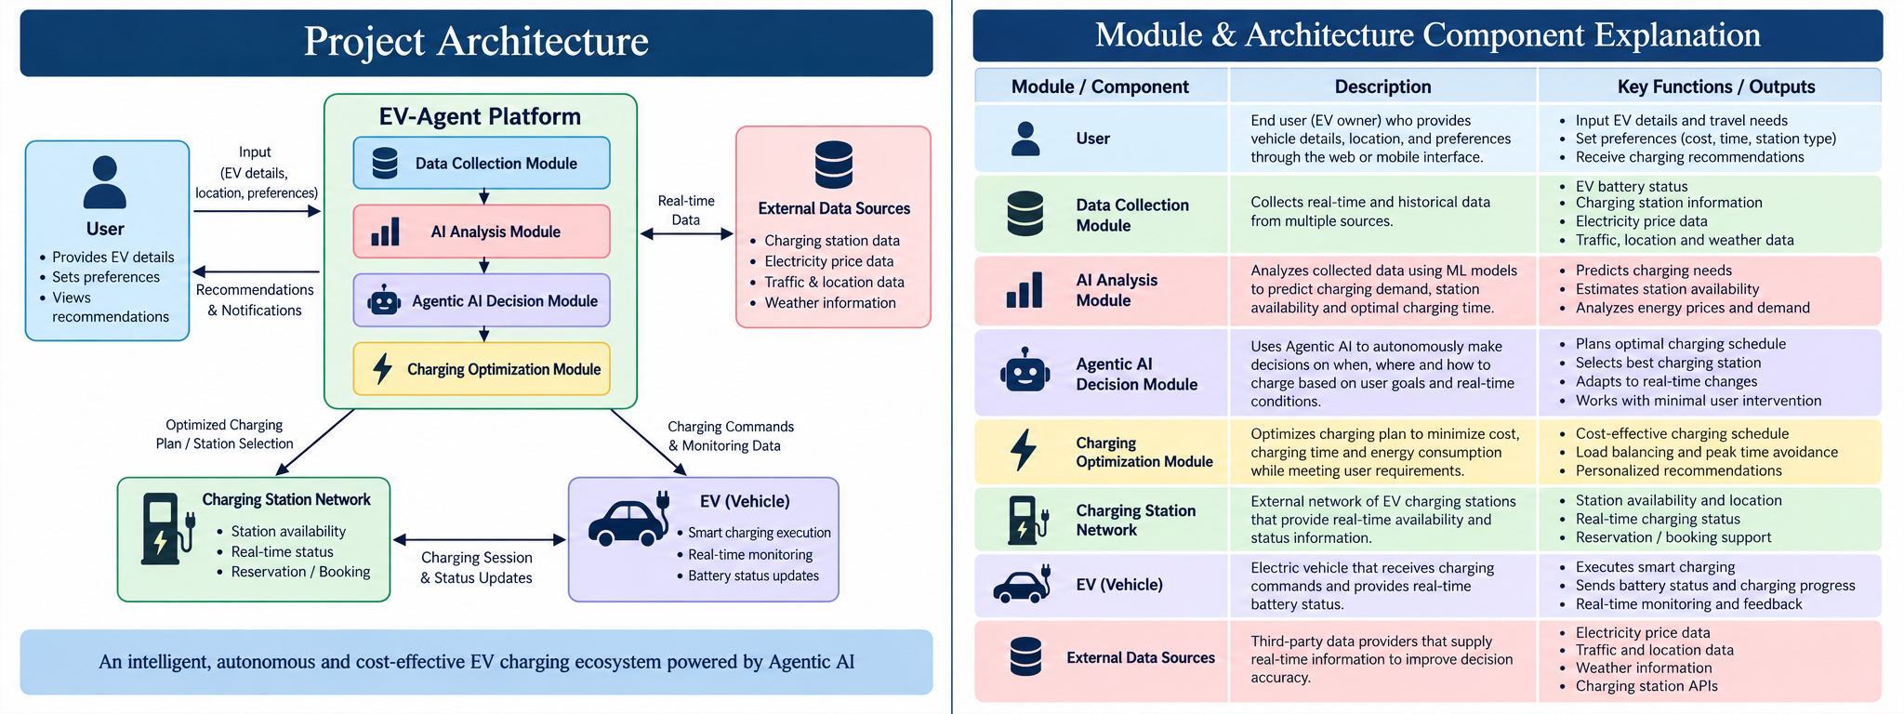
System Architecture
PRATHYUSHA ENGINEERING COLLEGE
(AN AUTONOMOUS INSTITUTION)
AIDS

Slide 11
PRATHYUSHA ENGINEERING COLLEGE
(AN AUTONOMOUS INSTITUTION)
Methodology / Workflow
The proposed system consists of six sequential steps, starting from EV and user data input and ending with personalized smart charging recommendations.
1. User & EV Data Input
Input Collection: User details, EV battery capacity, current State of Charge (SoC), vehicle range, destination, and preferred charging requirements are collected as input to the system.
2. Battery & Range Analysis
Battery Analysis: The system analyzes the current battery status, remaining range, estimated energy requirement, and expected consumption to determine whether charging is required.
AIDS

Slide 12
PRATHYUSHA ENGINEERING COLLEGE
(AN AUTONOMOUS INSTITUTION)
Conti..
3. Charging Station Data Collection
Station Data: Real-time charging station information such as location, availability, charger type, charging speed, distance, pricing, and operating status is collected.
4. Charging Demand Prediction
Demand Prediction: Machine learning models analyze battery status, travel distance, historical charging patterns, and station demand to estimate the required charging demand and suitable charging time.
AIDS

Slide 13
PRATHYUSHA ENGINEERING COLLEGE
(AN AUTONOMOUS INSTITUTION)
Conti..
5. Agentic AI Optimization
Intelligent Decision Making: The Agentic AI evaluates multiple factors such as distance, charging time, station availability, electricity cost, energy consumption, and user preferences to select an optimized charging station and charging schedule.
6. Personalized Recommendation & Monitoring
Smart Recommendation: The system provides a personalized charging recommendation, including the recommended station, charging time, estimated cost, and expected energy requirement, while continuously monitoring charging conditions and updating the recommendation when required.
AIDS

Slide 14
PRATHYUSHA ENGINEERING COLLEGE
(AN AUTONOMOUS INSTITUTION)
Technologies & Implementation
The proposed EV Charging Recommendation system is implemented using Python with libraries such as Pandas, NumPy, Scikit-learn, Matplotlib, and Seaborn. The system uses EV and charging-station datasets containing information such as battery capacity, State of Charge (SoC), vehicle range, charging demand, station availability, charging speed, distance, and charging cost. Pandas and NumPy are used for data preprocessing, cleaning, and numerical analysis, while machine learning techniques are used to predict charging demand and estimate EV requirements. The system integrates real-time charging-station information to evaluate available stations based on distance, availability, charging time, and cost.
AIDS

Slide 15
PRATHYUSHA ENGINEERING COLLEGE
(AN AUTONOMOUS INSTITUTION)
Technologies & Implementation
Software / Library / Module Used:
• Programming Language: Python
• Libraries: Pandas, NumPy, Scikit-learn
• Machine Learning Model: Random Forest Regressor for charging-demand prediction
• Prediction Inputs: Battery SoC, time, station usage, travel distance, and weather conditions
• Data Processing: Pandas and NumPy are used for data cleaning, preprocessing, and numerical analysis
• Evaluation Metrics: MAE, RMSE, and R² are used to evaluate prediction performance
AIDS

Slide 16
PRATHYUSHA ENGINEERING COLLEGE
(AN AUTONOMOUS INSTITUTION)
Conti..
Software / Library / Module Used:
• Mapping & Routing: OpenStreetMap and OSRM are used for location, distance, and route analysis
• Charging Station Data: Open Charge Map is used to obtain charging-station information and availability
• Weather Data: Open-Meteo is used to incorporate weather conditions into charging-demand analysis
• Agentic AI: Used for intelligent decision-making, station selection, cost and energy optimization, and personalized charging recommendations
• Backend & Database: Flask with SQLite/MySQL for API services, data management, and system integration
AIDS

Slide 17
PRATHYUSHA ENGINEERING COLLEGE
(AN AUTONOMOUS INSTITUTION)
Results
• Successfully collected and preprocessed EV and charging-station data for analysis and recommendation.
• Predicted charging demand using battery status, travel distance, charging patterns, and other relevant parameters.
• Identified suitable charging stations based on distance, charger availability, charging speed, and station status.
• Optimized charging station and charging time by considering user requirements, estimated charging duration, cost, and energy consumption.
• Agentic AI generated personalized charging recommendations by evaluating multiple factors and selecting an appropriate charging strategy.
AIDS

Slide 18
PRATHYUSHA ENGINEERING COLLEGE
(AN AUTONOMOUS INSTITUTION)
Conti..
• The system demonstrates the complete workflow: EV & User Input → Battery Analysis → Station Data → Demand Prediction → AI Optimization → Personalized Recommendation → Real-Time Monitoring.
• The proposed system reduces manual decision-making by providing intelligent, data-driven recommendations for efficient and convenient EV charging.
AIDS

Slide 19
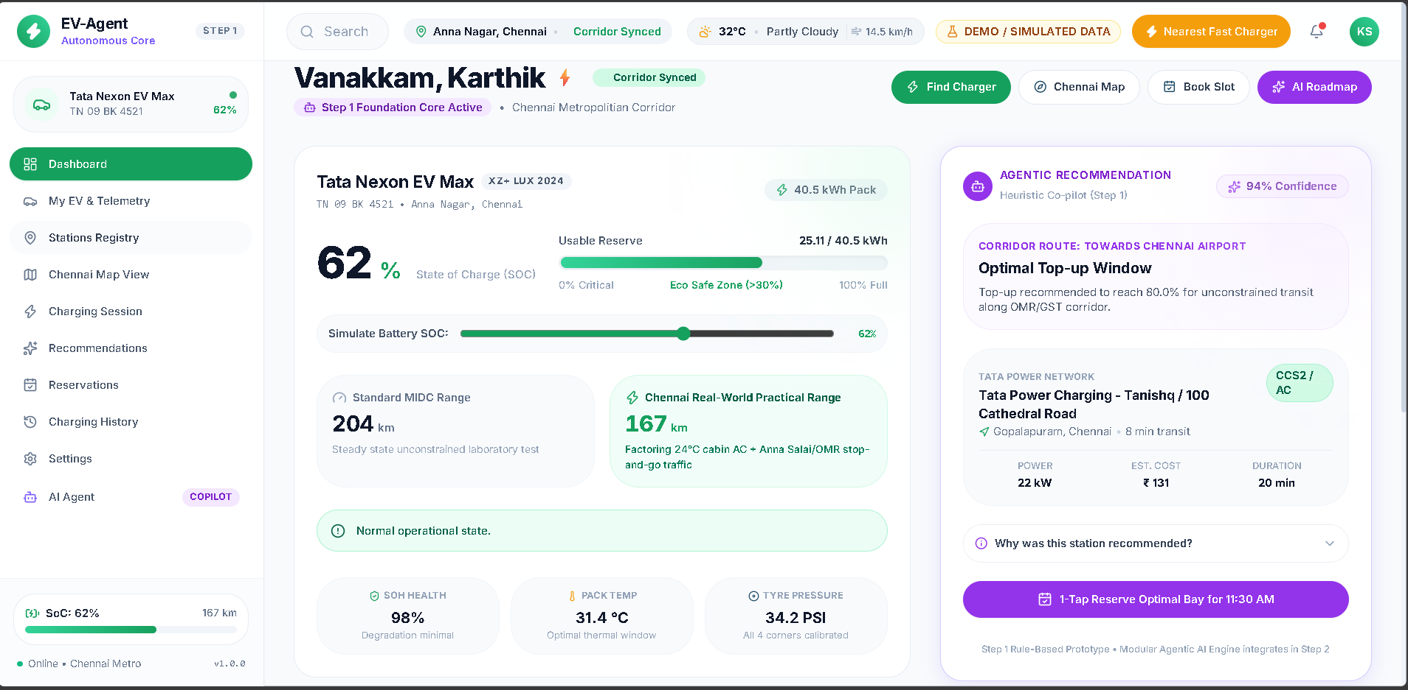
PRATHYUSHA ENGINEERING COLLEGE
(AN AUTONOMOUS INSTITUTION)
Output(Screen Shot)
AIDS

Slide 20
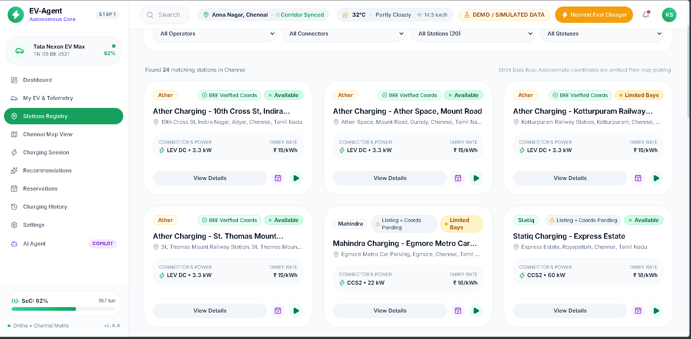
PRATHYUSHA ENGINEERING COLLEGE
(AN AUTONOMOUS INSTITUTION)
Conti..
AIDS

Slide 21
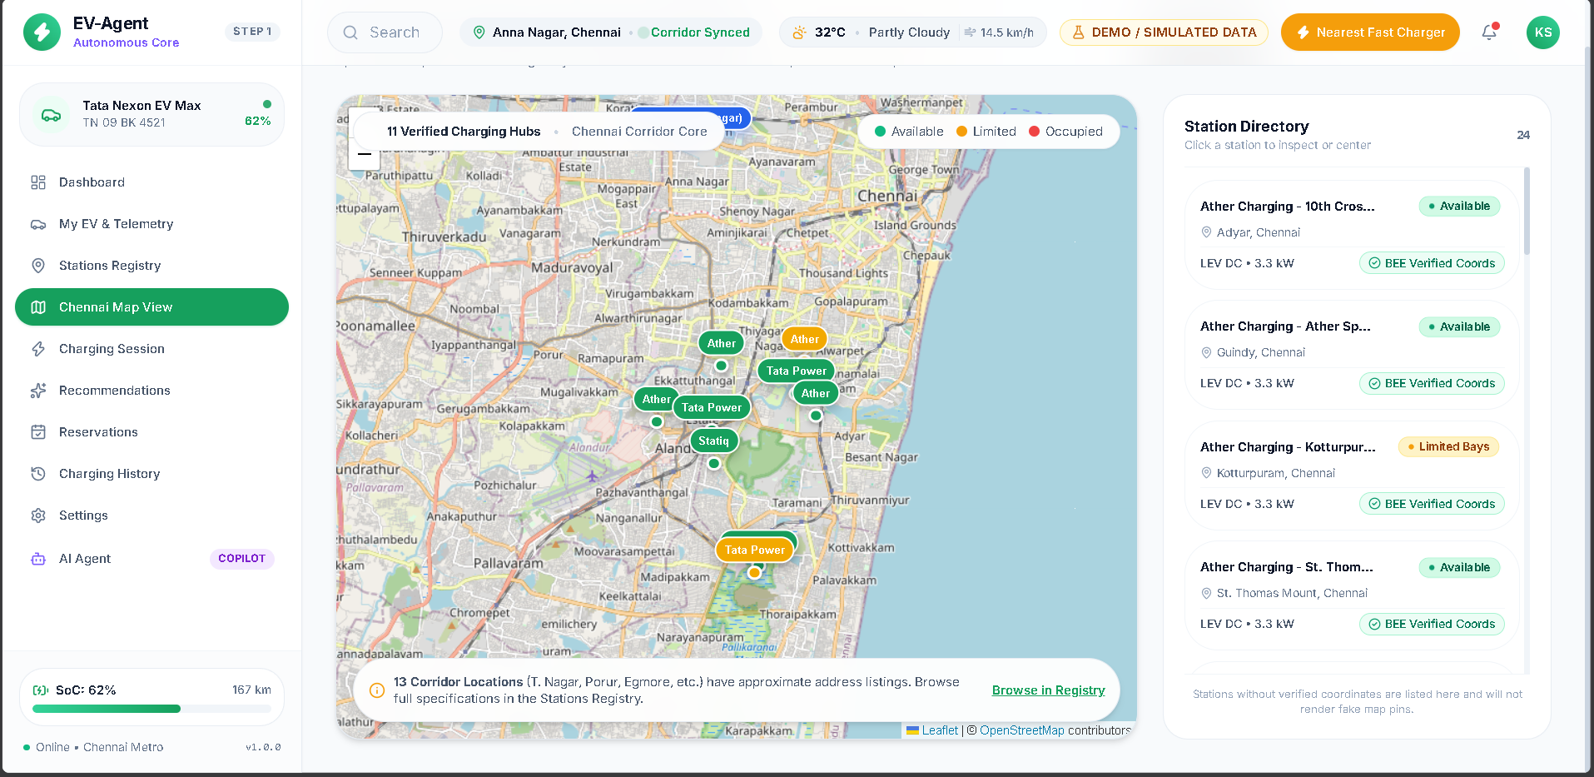
PRATHYUSHA ENGINEERING COLLEGE
(AN AUTONOMOUS INSTITUTION)
Conti..
AIDS

Slide 22
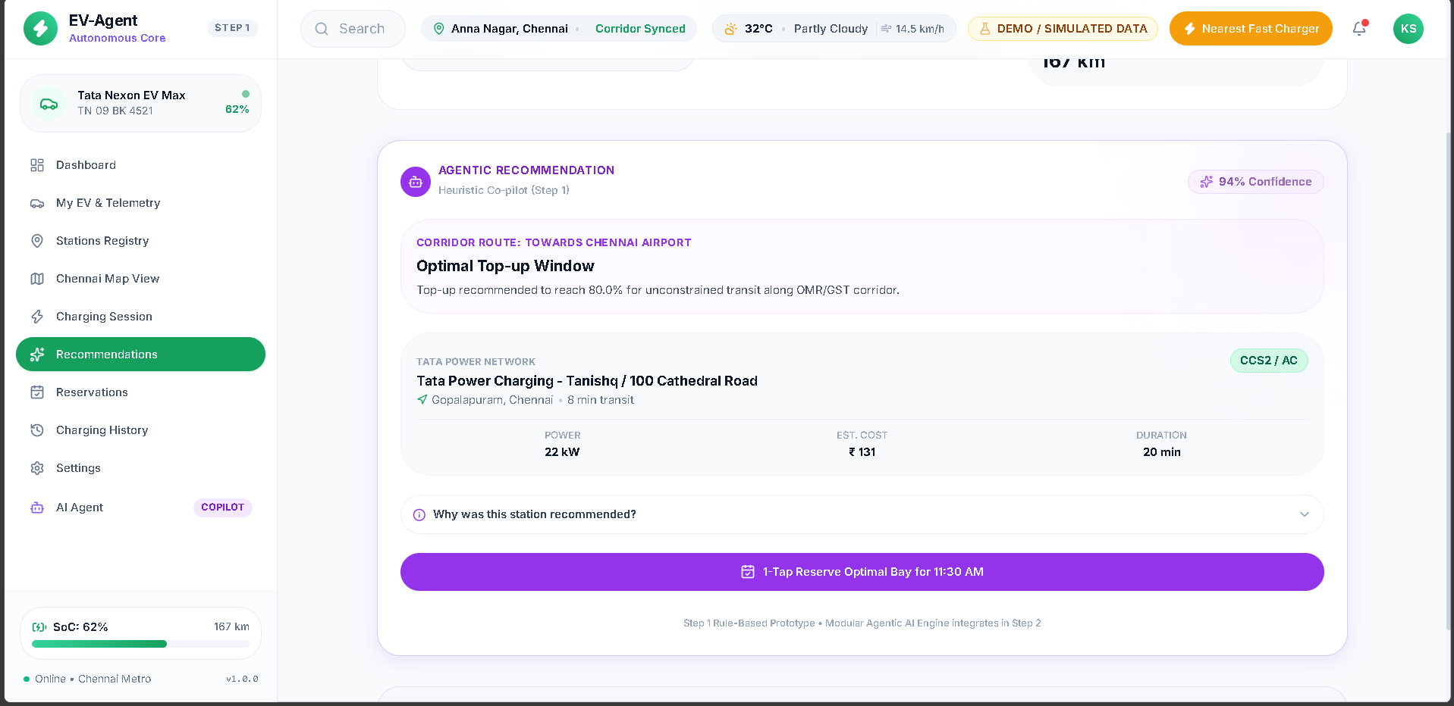
PRATHYUSHA ENGINEERING COLLEGE
(AN AUTONOMOUS INSTITUTION)
Conti..
AIDS

Slide 23
PRATHYUSHA ENGINEERING COLLEGE
(AN AUTONOMOUS INSTITUTION)
Conclusion
• The proposed EV Charging Recommendation System provides an intelligent and personalized approach to EV charging by combining battery analysis, charging-station data, demand prediction, and optimization techniques.
• The system analyzes user requirements, battery status, station availability, distance, charging time, cost, and energy consumption to identify suitable charging options.
• The integration of Agentic AI enables the system to make context-aware decisions and generate personalized charging recommendations instead of relying only on fixed rules.
AIDS

Slide 24
PRATHYUSHA ENGINEERING COLLEGE
(AN AUTONOMOUS INSTITUTION)
Future Scope
• Real-Time EV Integration: Integrate live vehicle data such as battery SoC, energy consumption, and remaining range directly from the EV.
• Advanced Demand Prediction: Use advanced Machine Learning and Deep Learning models to improve charging-demand and energy-consumption predictions.
• Dynamic Pricing Optimization: Incorporate real-time electricity tariffs and charging-station pricing to identify cost-efficient charging schedules.
• V2G Integration: Extend the system to support Vehicle-to-Grid (V2G) technology, allowing EVs to supply stored energy back to the grid when required.
AIDS

Slide 25
PRATHYUSHA ENGINEERING COLLEGE
(AN AUTONOMOUS INSTITUTION)
Future Scope
• Multi-Agent AI: Develop multiple specialized AI agents for route planning, station selection, energy optimization, and cost management.
• Smart Grid Integration: Connect the system with smart-grid infrastructure to balance charging demand and reduce peak-load conditions.
• Mobile Application: Develop a mobile application that provides live station availability, navigation, charging recommendations, and notifications.
• Predictive Maintenance: Use historical charging-station data to predict equipment failures and improve station reliability.
AIDS

Slide 26
PRATHYUSHA ENGINEERING COLLEGE
(AN AUTONOMOUS INSTITUTION)
References
International Energy Agency (IEA), “Global EV Outlook 2025,” International Energy Agency.
U.S. Department of Energy, Alternative Fuels Data Center (AFDC), Electric Vehicle Charging Infrastructure.
Open Charge Map, Global Electric Vehicle Charging Locations and Data.
OpenStreetMap Foundation, OpenStreetMap: Open Geographic Database.
OSRM, Open Source Routing Machine, Route and Distance Services.
Open-Meteo, Weather API and Forecast Data.
AIDS

Slide 27
PRATHYUSHA ENGINEERING COLLEGE
(AN AUTONOMOUS INSTITUTION)
PATENT/APPLICATION
EVChargeAI is a mobile application for smart and personalized EV charging recommendations.
Collects EV details, battery SoC, location, destination, and charging preferences.
Analyzes nearby charging stations, availability, distance, charging speed, and cost.
Uses Machine Learning and Agentic AI to predict charging demand and recommend the best-suited station and charging time.
Provides navigation, estimated charging cost, and real-time charging monitoring.
AIDS

Slide 28


